Slide 1
Deploying SDP Project into AWS Cloud
Done by:
Vulavalapudi Veda Manohara Sunanda 2000031095,
Siyyadri Sri Neeharika 2000032075

Slide 2
Step1 : create and SD Project of your own choice.
We have created Indian Culture Information System Project
Tools we used are : Spring boot, JavaScript for frontend
Hibernate, JPA Mapping, MySQL for backend

Slide 3
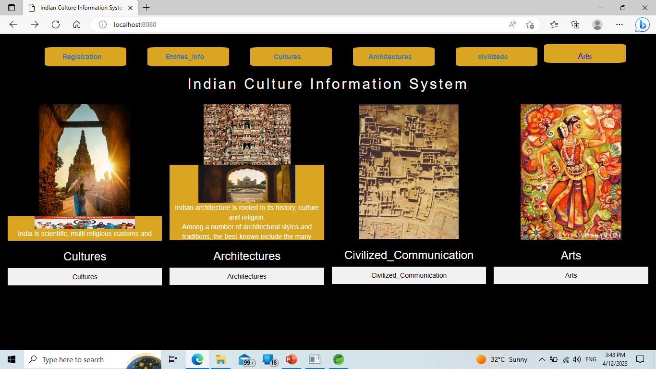

Slide 4
Step2 : Create an RDS with required username, password and using its endpoint create a connection

Slide 5
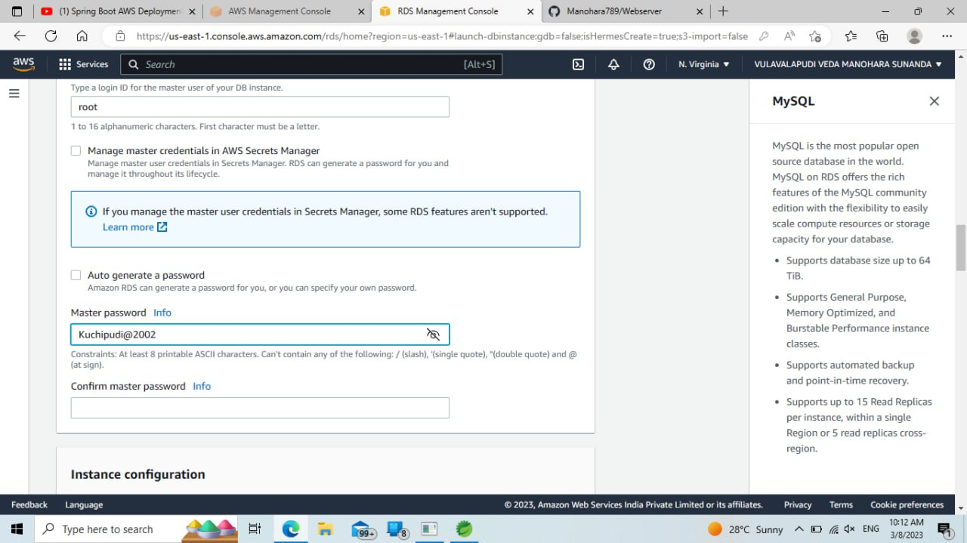


Slide 6
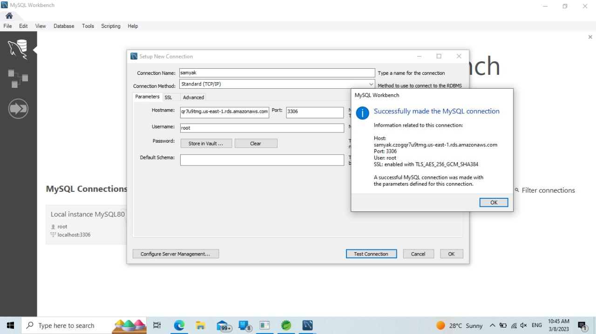

Slide 7
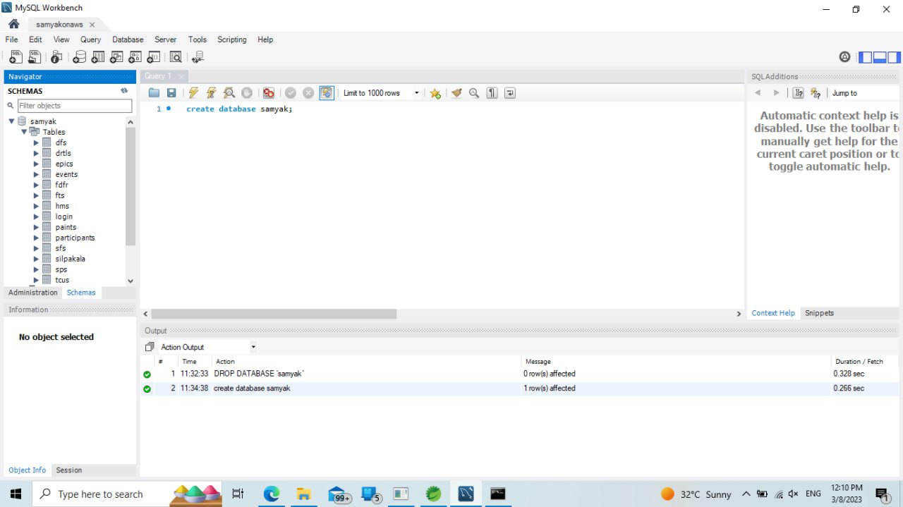


Slide 8
After establishing connection you copy endpoint to your “project application.properties” and open command prompt from the project location and enter “mvn clean install” to transfer tables to RDS database

Slide 9
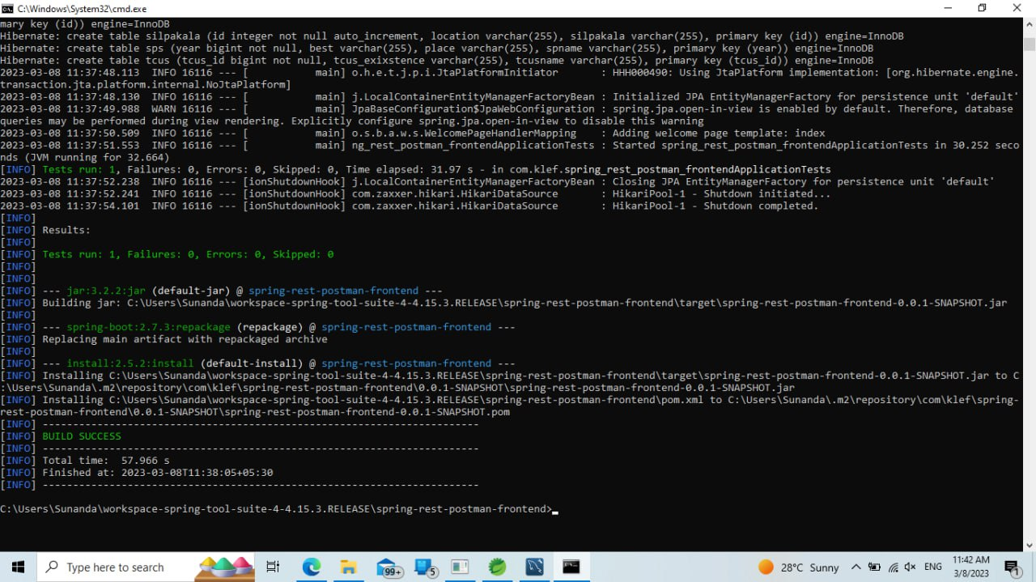

Slide 11
Apply “mvn clean package” to get a snapshot of your project and then upload it to your EBS by selecting JAVA as your runtime and
Edit : 1. Environment variables PORT_NUMBER : 5000
2. Database Settings USERNAME : root
PASSWORD

Slide 12
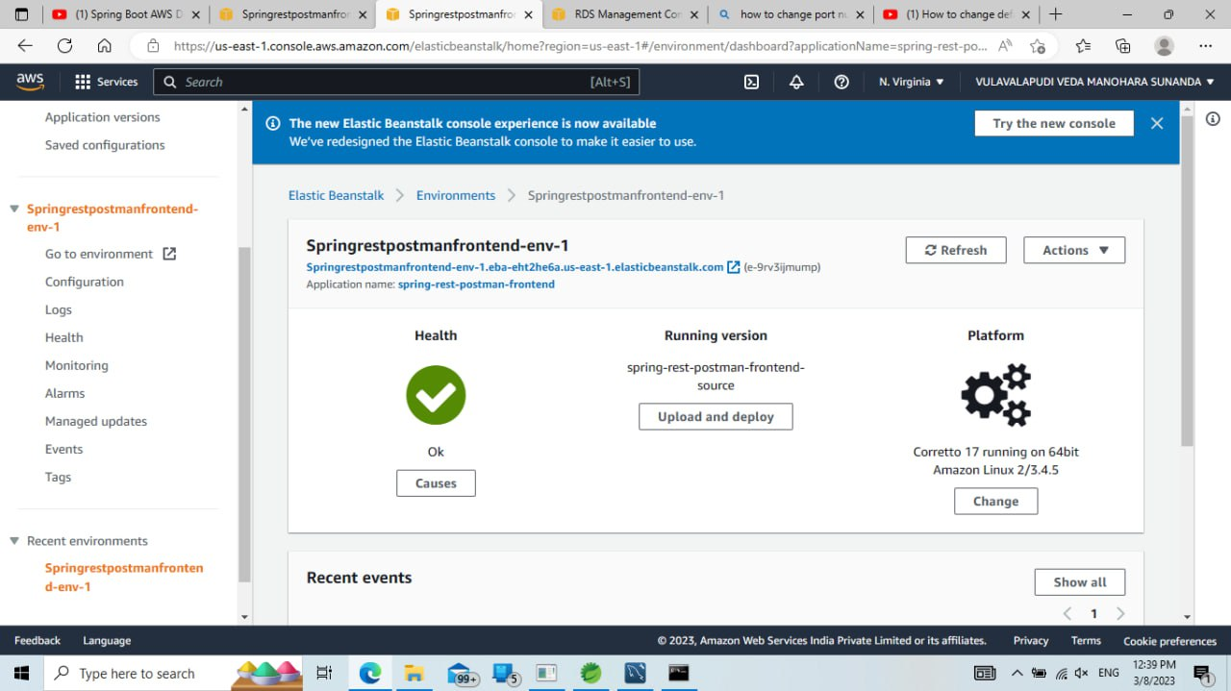

Slide 13
Edit Auto-created EC2 Instance Security group inbound rules to allow backend data also

Slide 14
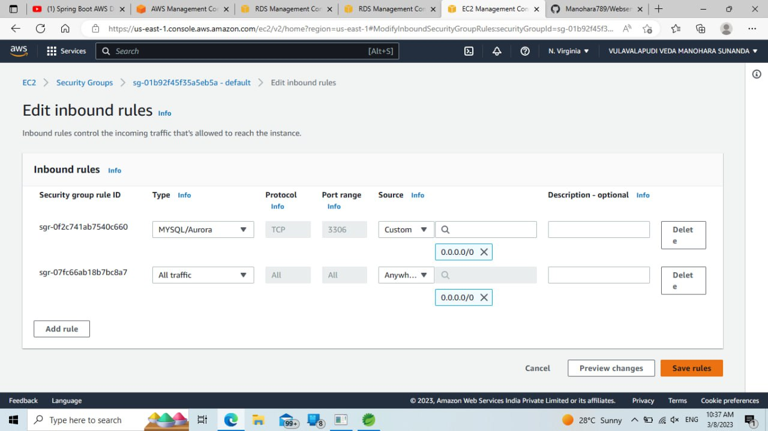

Slide 15
Take the help of EBS Application-> Environment URL and paste it in the POST MAN to check the request is working or not
We tried the registration page URL “POST MAPPING” and finally it worked.
We then analyzed that it has been hosted successfully.

Slide 16
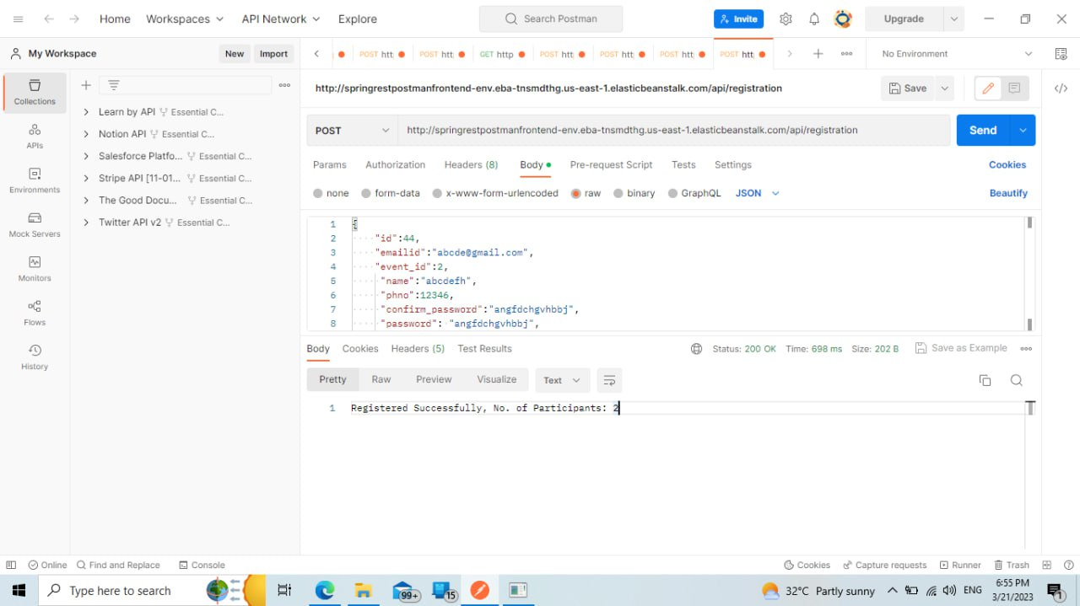

Slide 17
It is localhost machine frontend Registration page

Slide 18
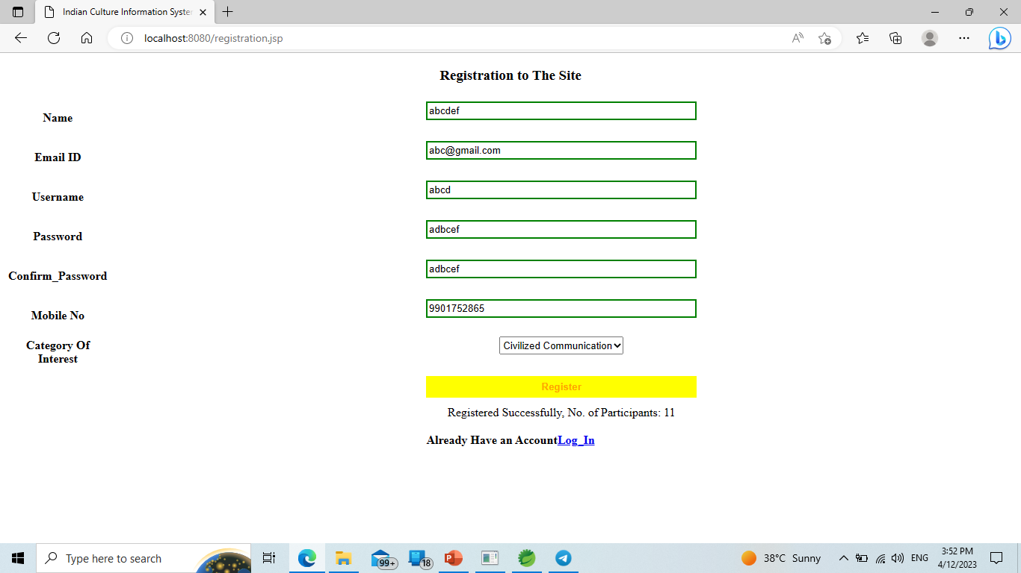

Slide 19
THANK YOU

Slide 20



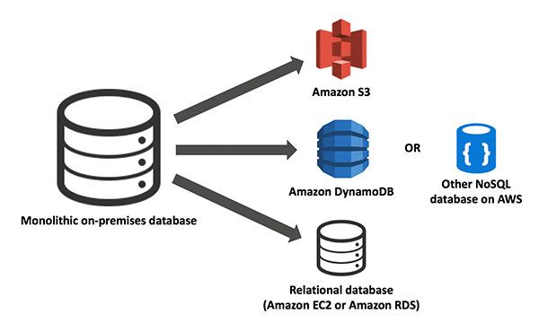



Slide 21
